Slide 1
KS2 SATs Guidance for Parents SPRING 2017
Wednesday 11th January 2017

Slide 2
KS2 Assessment – recent changes
A couple of years ago the government introduced a new national curriculum framework. The new curriculum is more rigorous and sets high expectations.
New SATs test for KS2, to reflect the new curriculum, were introduced last year.
A new system of reporting pupils achievement was also introduced.
‘Old’ national curriculum levels (e.g. Level 3, 4, 5) are no longer used.
Test results are now reported as a ‘scaled score.’
Your child will still be taught with the highest expectations and cover all required elements of the curriculum as in previous years.

Slide 3
Scaled Scores
What is meant by ‘scaled scores’?
A scaled score of 100 will always represent the ‘expected standard’.
Each pupil’s raw test score will therefore be converted into a score on the scale, either at, above or below 100.
The scale will have a lower end point somewhere below 100 and an upper end point above 100.
A child who achieves the ‘expected standard’ (a score of 100) will be judged to have demonstrated sufficient knowledge in the areas assessed by the tests.
Each pupil will receive:
A raw score (number of raw marks awarded).
A scaled score in each tested subject.
Confirmation of whether or not they attained the expected standard.

Slide 4
Scaled Score examples
A child awarded a scaled score of 100 is judged to have met the ‘expected standard’ in the area judged by the test.
A child awarded a scaled score of more than 100 is judged to have exceeded the expected standard and demonstrated a higher than expected knowledge of the curriculum for their age. There are no longer separate tests for the most able children. Instead, each test will have scope for higher attaining pupils to show their strengths.
A child awarded a scaled score of less than 100 is judged to have not yet met the expected standard and performed below expectation for their age.

Slide 5
The Tests
Key Stage 2 SATs take place nationally in the week commencing 8th May 2017.
Statutory tests will be administered in the following subjects:
Reading (60 minutes)
Spelling (approximately 15 minutes)
Punctuation, Vocabulary and Grammar (45 minutes)
Mathematics
- Paper 1: Arithmetic (30 minutes)
- Paper 2: Reasoning (40 minutes)
- Paper 3: Reasoning (40 minutes)
All tests are externally marked.
Writing and Science is ‘Teacher Assessed’ internally, as in previous years.

Slide 6
Tests must be taken on the specified date

Slide 7
Reading
The Reading Test consists of a single test paper with three unrelated reading texts.
Children are given 60 minutes in total, which includes reading the texts and answering the questions.
A total of 50 marks are available.
Questions are designed to assess the comprehension and understanding of a child’s reading.
Some questions are multiple choice or selected response, others require short answers and some require an extended response or explanation.

Slide 8
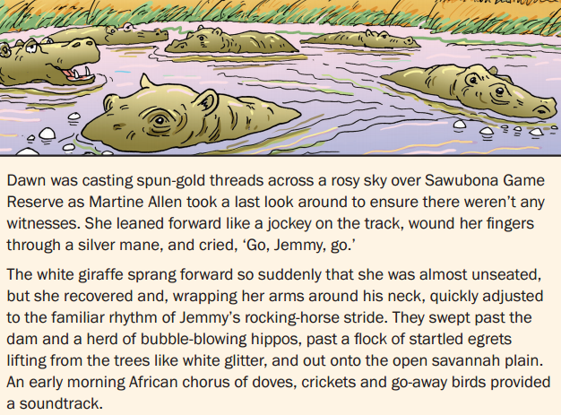
Sample Questions

Slide 9
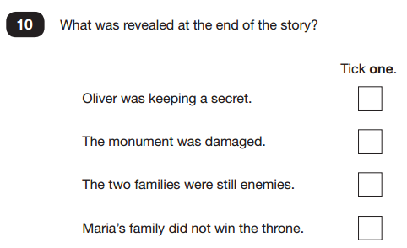
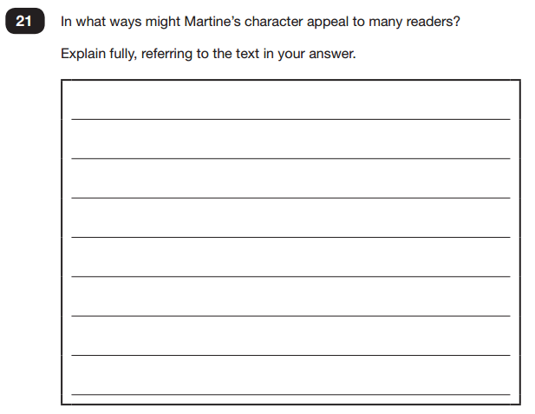
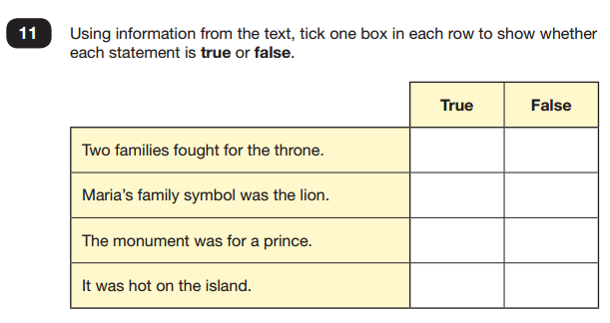
Sample Questions

Slide 10
Spelling, Punctuation and Grammar
A Spelling test is administered containing 20 words, lasting approximately 15 minutes. (20 marks)
A separate test is given on Punctuation, Vocabulary and Grammar.
This test lasts for 45 minutes and requires short answer questions, including some multiple choice. (50 marks)
Marks for these two tests are added together to give a total for Spelling, Punctuation and Grammar.

Slide 11
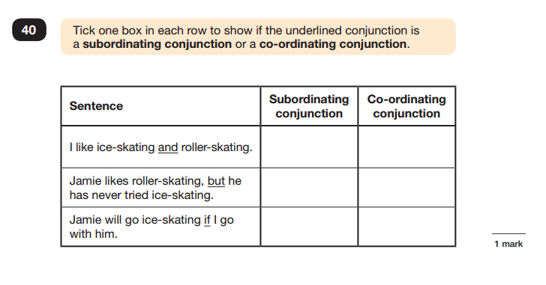
Sample Questions

Slide 12
Mathematics
Children will sit three tests: Paper 1, Paper 2 and Paper 3.
Paper 1 is for ‘Arithmetic’ lasting for 30 minutes, covering calculation methods for all operations, including use of fractions, percentages and decimals. (40 marks)
Questions gradually increase in difficulty. Not all children will be expected to access some of the more difficult questions later in the paper.
Papers 2 and 3 cover ‘Problem Solving and Reasoning’, each lasting for 40 minutes. (35 marks per paper)
Pupils will still require calculation skills but will need to answer questions in context and decide what is required to find a solution.

Slide 13
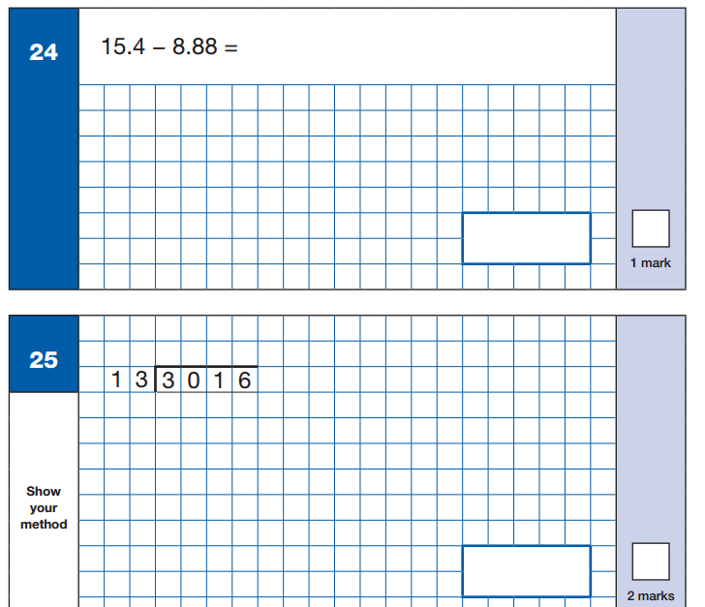
Sample Questions – paper 1

Slide 14
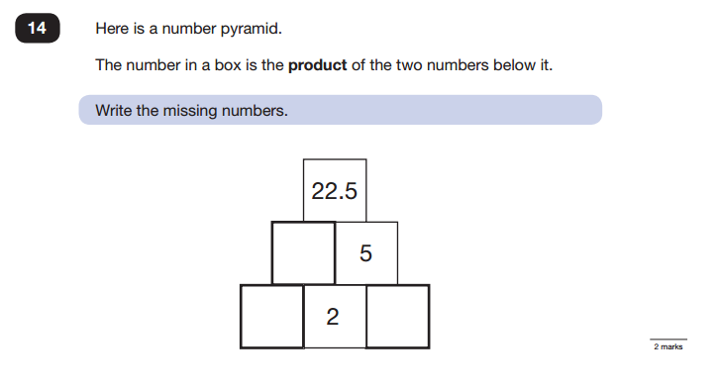
Sample Questions – paper 2&3

Slide 15
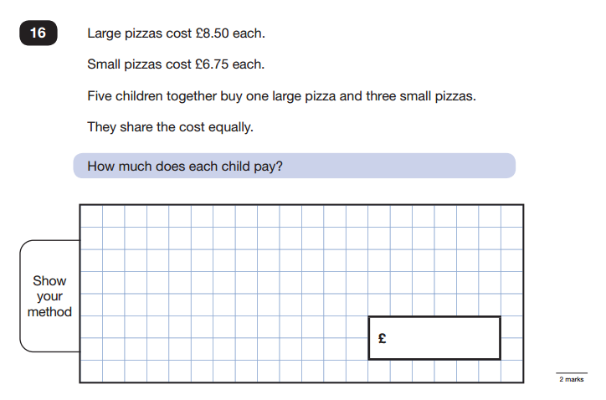
Sample Questions – paper 2&3

Slide 16
Teacher Assessment
Writing and Science are only assessed through teacher assessment – there are no tests for writing and science.
To help with teacher assessment the DfE produced ‘Interim Frameworks’ in 2016.
They set out the standards a pupil will be assessed against in writing and science. There are also standards for maths and reading.
The Interim Frameworks draw on the National Curriculum expectations and focuses only on the key aspects for assessment. Pupils achieving the different standards within this interim framework will also be able to demonstrate a broader range of skills than those being assessed.
All of the criteria must be met for a child to attain the ‘Expected Standard’.

Slide 17
Writing Teacher Assessments
Children not meeting the WORKING TOWARDS ‘Expected Standard’ category for a pupil at the end of Year 6
WORKING TOWARDS the ‘Expected Standard’ for a pupil at the end of Year 6
WORKING AT the ‘Expected Standard’ for a pupil at the end of Year 6
WORKING AT GREATER DEPTH within the ‘Expected Standard’ for a pupil at the end of Year 6
For Science, Reading and Maths pupils will be grouped into 2 categories --‐ Working at the expected standard, or a category for those pupils who do not meet the standard.

Slide 18
What is the ‘Expected Standard’ in writing?
Last year the DfE issued some guidance for schools showing examples of pupils writing which had been assessed as meeting the ‘Expected Standard’, working towards the ‘Expected Standard’ and working at greater depth within the ‘Expected Standard’.
Pupils are assessed not just through one piece of writing but across a range of pieces.
Children are expected to be able to write using a range of different genres.

Slide 19
How to help your child
First and foremost, support and reassure your child that there is nothing to worry about and they should always just try their best. Praise and encourage!
Ensure your child has the best possible attendance at school.
Support your child with any homework tasks.
Reading, spelling and arithmetic (e.g. times tables) are always good to practise.
Talk to your child about what they have learnt at school and what book(s) they are reading (the character, the plot, their opinion).
Make sure your child has a good sleep and healthy breakfast every morning. We provide breakfast for any year 6 pupil who wants to attend on Monday to Thursday of SATs week.

Slide 20
How to help your child with reading
Listening to your child read can take many forms.
First and foremost, focus on developing an enjoyment and love of reading.
Enjoy stories together – reading stories to your child is equally as important as listening to your child read.
Read a little at a time but often, rather than rarely but for long periods of time!
Talk about the story before, during and afterwards – discuss the plot, the characters, their feelings and actions, how it makes you feel, predict what will happen and encourage your child to have their own opinions.
Look up definitions of words together – you could use a dictionary, the internet or an app on a phone or tablet.
All reading is valuable – it doesn’t have to be just stories. Reading can involve anything from fiction and non-fiction, poetry, newspapers, magazines, football programmes, TV guides.
Visit the local library - it’s free!

Slide 21
How to help your child with writing
Practise and learn weekly spelling lists – make it fun!
Encourage opportunities for writing such as letters to family or friends, shopping lists, notes or reminders, stories or poems.
Write together – be a good role model for writing.
Encourage use of a dictionary to check spelling and a thesaurus to find synonyms and expand vocabulary.
Allow your child to use a computer for word processing, which will allow for editing and correcting of errors without lots of crossing out.
Remember that good readers become good writers! Identify good writing features when reading (e.g. vocabulary, sentence structure, punctuation).
Show your appreciation: praise and encourage, even for small successes!

Slide 22
How to help your child with maths
Play times tables games
Play mental maths games including counting in different amounts, forwards and backwards.
Encourage opportunities for telling the time.
Encourage opportunities for counting coins and money; finding amounts or calculating change when shopping.
Look for numbers on street signs, car registrations and anywhere else!
Look for examples of 2D and 3D shapes around the home.
Identify, weigh or measure quantities and amounts in the kitchen or in recipes.
Play games involving numbers or logic, such as dominoes, card games, darts, draughts or chess.

