Slide 1
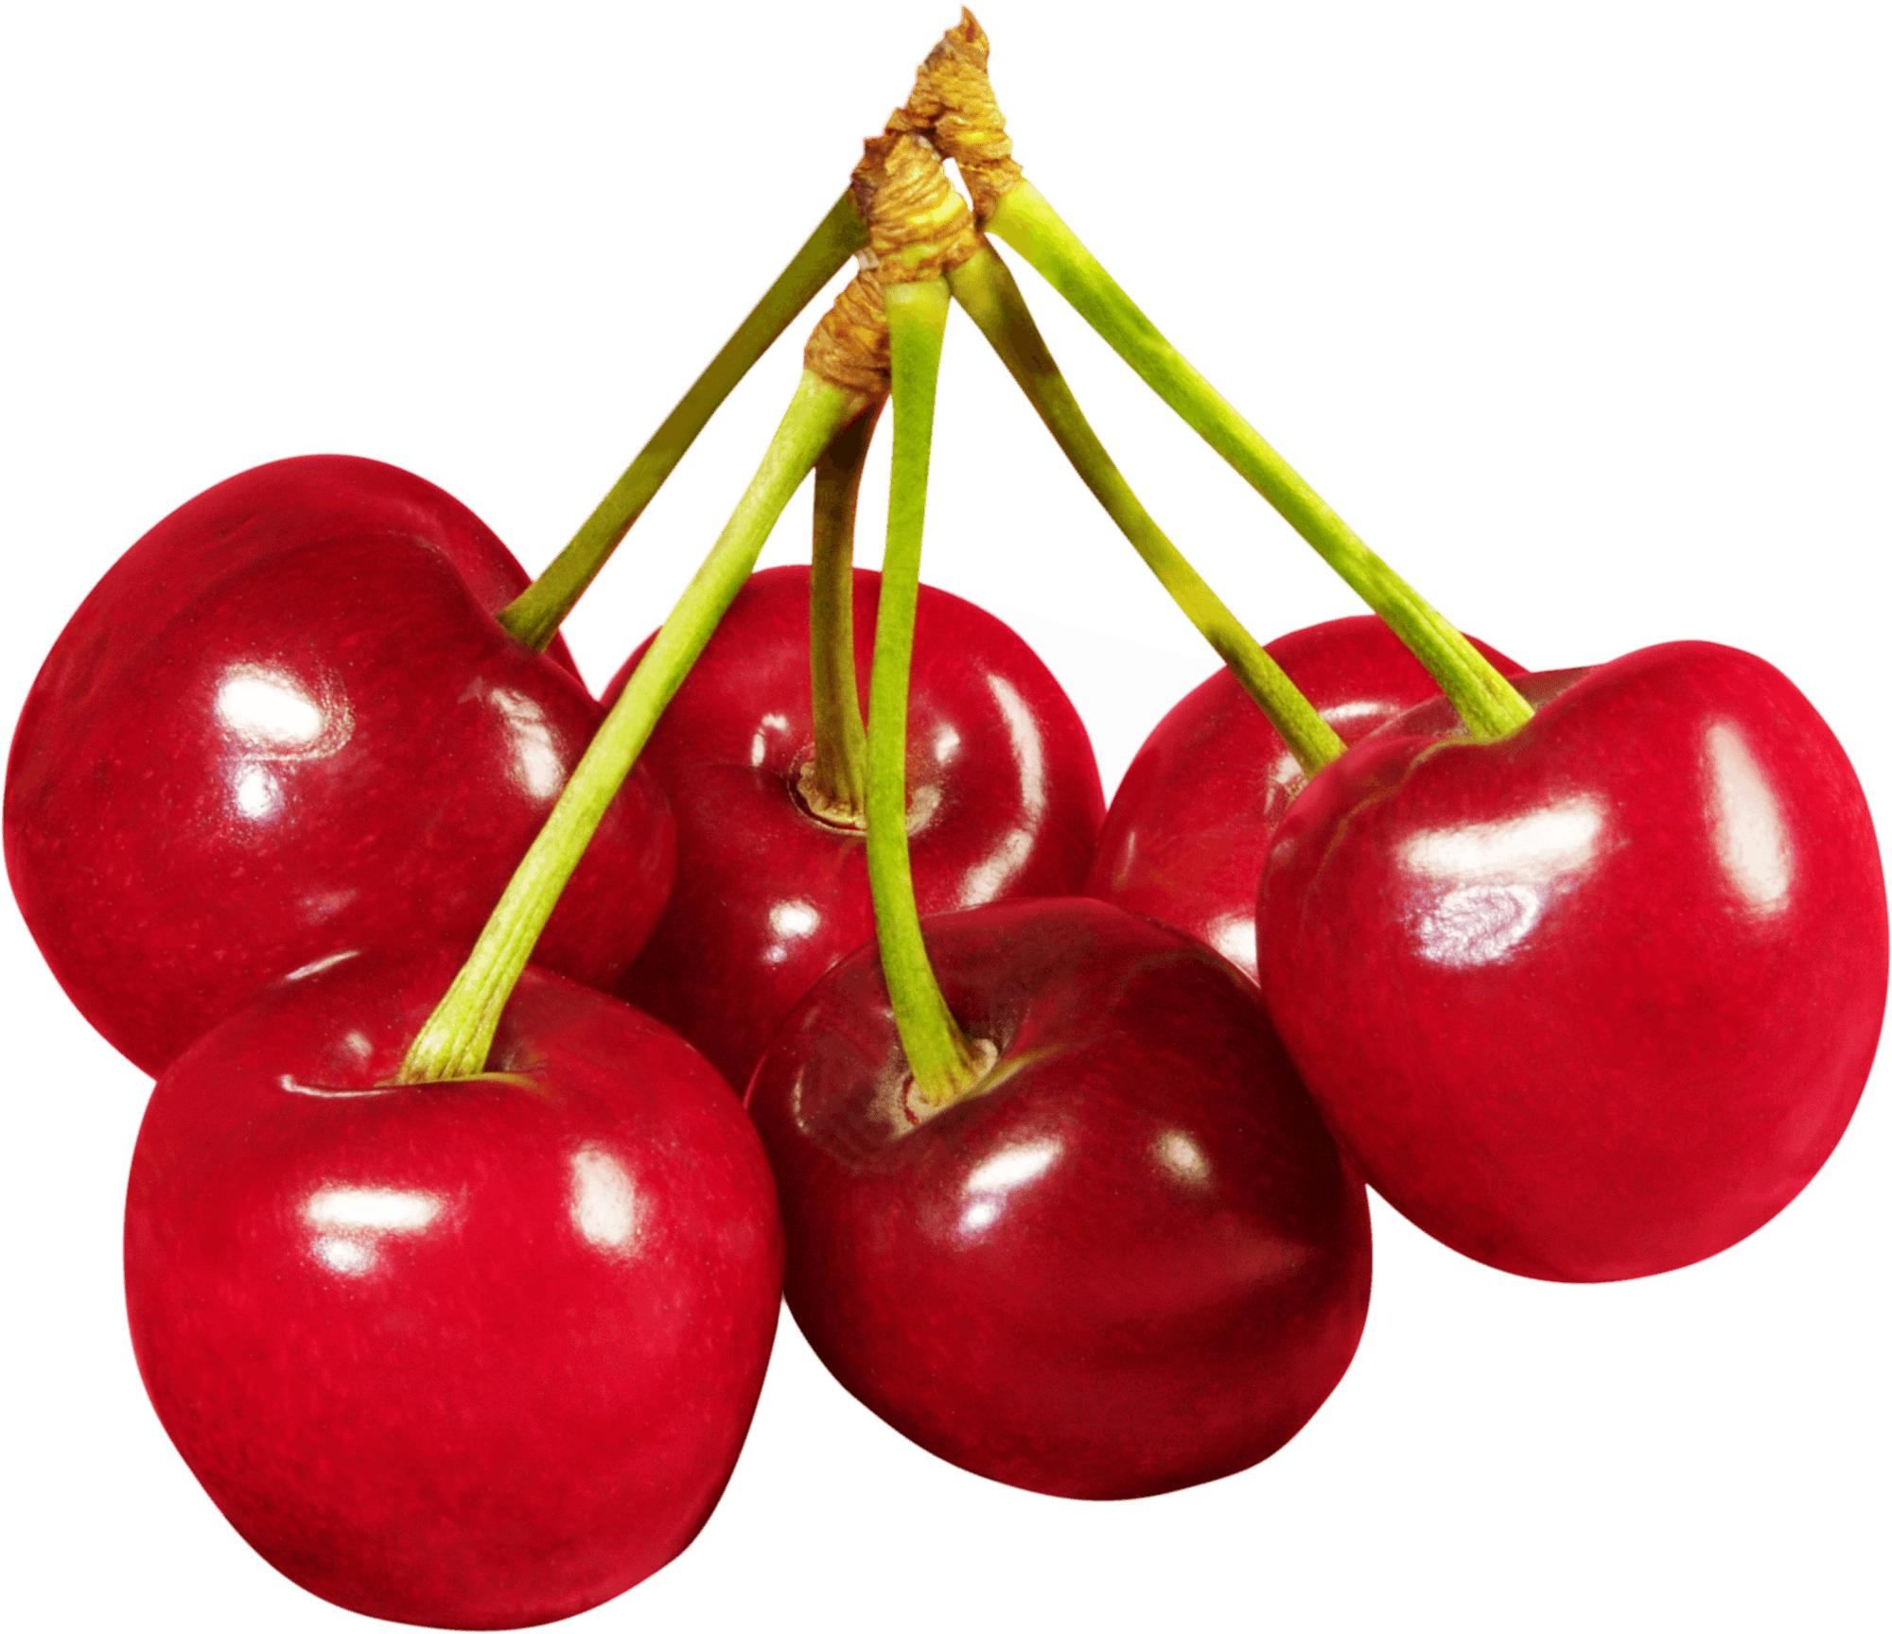
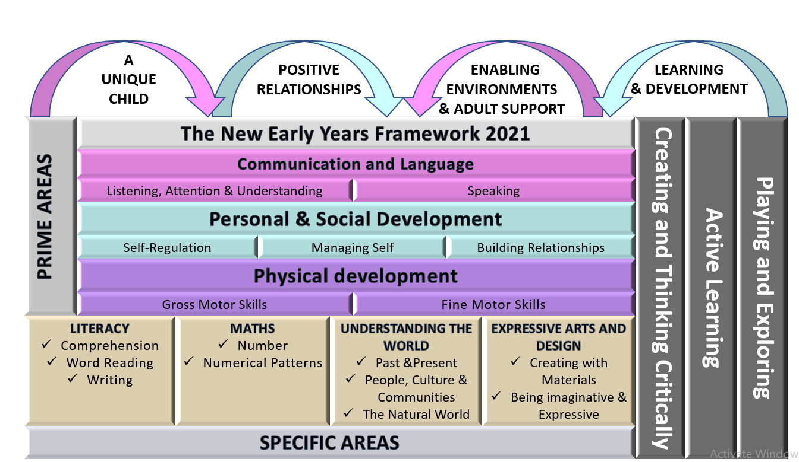
Nursery Long
Term Plan 25/26
“Children will an abundance of opportunities to learn through play both inside and out. We will ensure that learning will be fun, engaging and we will challenge and support all children where ever their starting point. As an EYFS team and effective role models, we will provide high quality interactions in order to develop and deepen all children’s learning opportunities. We will deliver our curriculum through a balance of adult led and child-initiated activities based on the EYFS Framework 21’ & children’s interests.” Cherry Lane EYFS Team”

Slide 2


Cherry Lane Nursery Long Term Plan 25-26
 | Autumn 1 | Autumn 2 | Spring 1 | Spring 2 | Summer 1 | Summer 2
General Themes | All About me! | Festivals and celebrations! | Ticket to ride! | Homes and animals! | Smell the flowers! | Fun at the seaside!
Over Arching Principles | Characteristics of Effective Learning Playing and exploring: - Children investigate and experience things, and ‘have a go’. Children who actively participate in their own play develop a larger store of information and experiences to draw on which positively supports their learning Active learning: - Children concentrate and keep on trying if they encounter difficulties. They are proud of their own achievements. For children to develop into self-regulating, lifelong learners they are required to take ownership, accept challenges and learn persistence. Creating and thinking critically: - Children develop their own ideas and make links between these ideas. They think flexibly and rationally, drawing on previous experiences which help them to solve problems and reach conclusions.
Over Arching Principles | Unique Child: Every child is unique and has the potential to be resilient, capable, confident and self-assured. Positive Relationships: Children flourish with warm, strong & positive partnerships between all staff and parents/carers. This promotes independence across the EYFS curriculum. Children and practitioners are NOT alone – embrace each community. Enabling environments: Children learn and develop well in safe and secure environments where routines are established and where adults respond to their individual needs and passions and help them to build upon their learning over time. Learning and Development: Children develop and learn at different rates (not in different ways as it stated 2017). We must be aware of children who need greater support than others. PLAY: At Cherry Lane Primary School, we understand that children learn best when they are absorbed, interested and active. We understand that active learning involves other children, adults, objects, ideas, stimuli and events that aim to engage and involve children for sustained periods. We believe that Early Years education should be as practical as possible and therefore , we are proud that our EYFS setting has an underlying ethos of ‘Learning through play. PLAY is essential for children’s development across all areas. Play builds on children’s confidence as they learn to explore, to relate to others around them and develop relationships , set their own goals and solve problems. Children learn by leading their own play and by taking part in play which is guided by adults.’. EYFS Team We will ensure that all children learn and develop well and are kept healthy and safe at ALL times.
Characteristics of effective Learning

Slide 3






Cherry Lane Nursery Long Term Plan 25-26
 | Autumn 1 | Autumn 2 | Spring 1 | Spring 2 | Summer 1 | Summer 2
General Themes these themes may be adapted at various points to allow for children’s interests to flow through the provision | All About me! Starting nursery / my new friends / New Beginnings My emotions/ growing up People who help us / Careers My body/ My senses How have I changed? My family / PSED focus What am I good at? How do I make others feel? Being kind / staying safe My special people | Festivals and celebrations! Bonfire night/ Remembrance day/ Diwali/ children in need/ Autumn/ Halloween The Nativity Christmas Lists Letters to Father Christmas | Ticket to ride! Around the Town How do I get there? Where in the world have you been? Journeys Fly me to the moon! Vehicles past and Present Design your own transport! | Homes and animals! Pets/zoo/safari/forest/ jungle animals and where they like to live | Smell the flowers! Life cycles Safari Animals around the world Climates / Hibernation Down on the Farm Min Beasts Animal Arts and crafts Night and day animals Animal patterns Planting seeds | Fun at the Seaside! Under the sea Off on holiday / clothes Where in the world shall we go? Send me a postcard! Marine life Seaside's in the past Compare: Now and then! Seaside art Sun safety
Quality Texts and Nursery Rhymes | Quality Texts Maisy goes to Nursery, Starting School, Nursery Not today!, My Mum, My Dad, Paper dolls, Fred the fearless fireman, The Colour Monster, The listening Walk, Rama and Sita, Winnie the witch, Ghost hunt. Nursery rhymes Heads, shoulders knees and toes, finger family song, Jack and Jill, Miss Polly, Ring of roses, Humpty Dumpty, Incy wincey spider | Quality Texts Ferdie and the falling leaves, Supertato, The little red hen cooks pizza, The tiger who came to tea, Oliver's vegetable, The Christmas story, Christmas Story / Nativity Father Christmas needs the loo! The Jolly Christmas Postman Nursery rhymes Hickory Dickory Dock, 10 fat sausages, 5 current buns, 10 green bottles, oranges and lemons, twinkle,twinkle little star | Quality Texts Lets take a trip, The train ride, Whatever next, The Journey, Chinese new year, Frog in Winter, A little bit of Winter, Teddy takes a tumble, Traffic and raod safety Nursery rhymes Row, row row your boat, the wheels on the bus, the grand old duke of York, 10 green bottles, 2 little Dickie birds, Skidamirink | Quality Texts A squash and a squeeze, Poo in the zoo, Poles apart, Owl babies, Rumble in the jungle, We’re going on a bear hunt, Nursery rhymes Old mac Donald had a farm, We’re going to the zoo, 1,2,3,4,5, two little dickie birds, the ants go marching, hot cross buns. | Quality Texts Fran’s flower, the crunching munching caterpillar, If Only, Yum Yum, 10 Seeds, Sonya’s chickens, Williams Wild Garden, The very Hungry caterpillar Nursery Rhymes Here we go around the mulberry bush, Incy wincy spider, Mary Mary quite contrary,Rounds and round the garden, 5 little ducks, ring a ring of roses | Quality Texts Billy’s Bucket, Lighthouse Keeper’s Lunch Under the Sea Non – Fiction Lighthouse keepers lunch, The Snail and the Whale, Commotion in the ocean, Sharing a shell, The singing mermaid, Rainbox Fish, Pirates love Underpants! Nursery Rhymes 1,2,3,4,5, A sailor went to sea sea sea, Row row row your boat, She sells sea shells,
Enrichment Weeks | Autumn walk Remembrance Day Harvest Time Birthdays Favourite Songs Halloween What do I want to be when I grow up? Life Bus Fireman | Weekly parent cooking, Guy Fawkes / Bonfire Night Christmas Time / Nativity Diwali Hannukah Black History Month Remembrance day Road Safety Children in Need Anti- Bullying Week | Chinese New Year LENT Story Telling Week Random Acts of Kindness Week Valentine’s Day Internet Safety Day Animal Art week | Easter time Weather experiments Let’s go on Safari - An animal a day! Mother’s Day Queen’s Birthday Science Week Eater Egg Hunt | Post a letter Weather Forecast videos Nature Scavenger Hunt Start of Ramadan Eid Planting seeds | Visit to the beach Under the Sea – singing songs and sea shanties Father’s Day World Environment Day Pirate Day Map work - Find the Treasure Picnic at the beach Graduation week!

Slide 4
Cherry Lane Nursery Long Term Plan 25-26
 | Autumn 1 | Autumn 2 | Spring 1 | Spring 2 | Summer 1 | Summer 2
General Themes | All About me! | Festivals and celebrations! | Ticket to ride! | Homes and animals! | Smell the flowers! | Fun at the seaside!
Our Values Assemblies / Sharing Circles These will mirror the principles and values of our school & Cherry Lane Way. We will ‘dip in and out of each area’ each term as and when we need to. | Mutual respect We are all unique. We respect differences between different people and their beliefs in our community, in this country and all around the world. All cultures are learned , respected, and celebrated. | Mutual Tolerance Everyone is valued, all cultures are celebrated and we all share and respect the opinions of others. Mutual tolerance of those with different faiths and beliefs and for those without faith. | Rule of law We all know that we have rules at school that we must follow. We know who to talk to if we do not feel safe. We know right from wrong. We recognise that we are accountable for our actions. We must work together as a team when it is necessary. | Individual liberty We all have the right to have our own views. We are all respected as individuals. We feel safe to have a go at new activities. We understand and celebrate the fact that everyone is different. | Democracy We all have the right to be listened to. We respect everyone and we value their different ideas and opinions. We have the opportunity to play with who we want to play with. We listen with intrigue and value and respect the opinions of others. | Recap all British Values Fundamental British Values underpin what it is to be a citizen in a modern and diverse Great Britain valuing our community and celebrating diversity of the UK. Fundamental British Values are not exclusive to being British and are shared by other democratic countries.
Assessment opportunities | Baseline/on entry Nursery Assessments In-house - Baseline data on entry National Baseline data by end of term Set up Evidence Me | On going assessments Baseline analysis Pupil progress meetings Parents evening info EYFS team meetings In house moderation Midterm Assessments Attention Hillingdon data drop | GLD Projections for Reception Team moderation EYFS team meetings Phase meeting and internal moderations | Pupil progress meetings Parents meeting info EYFS team meetings Evidence Me Data Attention Hillingdon data drop | Team moderation GLD Projections for Reception EYFS team meetings | Pupil progress meetings EYFS team meetings Evidence Me data EOY data Attention Hillingdon data drop
Parental Involvement | Staggered Start Harvest Assembly Home / School Agreement Initmate care plans Library books sent home | Nursery Nativity Autumn craft event, stay and play session Book at Bedtime Library books sent home | Share a story Stay and Read morning Look at me! Talent show! Library books sent home | Parents Evening Art workshop / Gallery Share a story Library books sent home | Proud Clouds Share a story Library books sent home | Home visits Nursery/ Reception Reception transition session Share a story Parents meetings Parent’s Picnic

Slide 5

Cherry Lane Nursery Long Term Plan 25-26
 | Autumn 1 | Autumn 2 |  | Spring 1 |  | Spring 2 |  | Summer 1 |  | Summer 2
General Themes | All About me! | Festivals and celebrations! |  | Ticket to ride! |  | Homes and animals! |  | Smell the flowers! |  | Fun at the seaside!
Communication and Language Talk to parents about what language they speak at home, try and learn a few key words and celebrate multilingualism in your setting. | The development of children’s spoken language underpins all seven areas of learning and development. Children’s back-and-forth interactions from an early age form the foundations for language and cognitive development. The number and quality of the conversations they have with adults and peers throughout the day in a language-rich environment is crucial. By commenting on what children are interested in or doing, and echoing back what they say with new vocabulary added, practitioners will build children's language effectively. Reading frequently to children, and engaging them actively in stories, non-fiction, rhymes and poems, and then providing them with extensive opportunities to use and embed new words in a range of contexts, will give children the opportunity to thrive. Through conversation, story-telling and role play, where children share their ideas with support and modelling from their teacher, and sensitive questioning that invites them to elaborate, children become comfortable using a rich range of vocabulary and language structures.
Whole EYFS Focus – C&L is developed throughout the year through high quality interactions, daily group discussions, sharing circles, PSHE times, stories, singing, speech and language interventions,, EYFS productions and weekly interventions. Daily story time Communication and Language OBJECTIVES | Welcome to Nursery Settling in activities Making friends Children talking about experiences that are familiar to them What are your passions / goals / dreams? This is me! Rhyming and alliteration Familiar Print Sharing facts about me! Mood Monsters Shared stories All about me! Model talk routines through the day. For example, arriving in school: “Good morning, how are you?” |  | Take me home! Settling in activities Develop vocabulary Discovering Passions Take me home- retelling events that have happened to me Story language Word hunts Listening and responding to stories Following instructions Takes part in discussion Understand how to listen carefully and why listening is important. Use new vocabulary through the day. Choose books that will develop their vocabulary. |  | Tell me why! Using language well Ask’s how and why questions… Discovering Passions Retell a story with story language Story invention – talk it! Ask questions to find out more and to check they understand what has been said to them. Describe events in some detail. Listen to and talk about stories to build familiarity and understanding. Learn rhymes, poems and songs. |  | Talk it through! Settling in activities for new children Describe events in detail – time connectives Discovering Passions Understand how to listen carefully and why listening is important. Use picture cue cards to talk about an object: “What colour is it? Where would you find it? Sustained focus when listening to a story |  | What happened? Discovering Passions Re-read some books so children learn the language necessary to talk about what is happening in each illustration and relate it to their own lives |  | Time to share! Show and tell Weekend news Discovering Passions Read aloud books to children that will extend their knowledge of the world and illustrate a current topic. Select books containing photographs and pictures, for example, places in different weather conditions and seasons.
 | •Enjoy listening to longer stories and can remember much of what happens. • Pay attention to more than one thing at a time, which can be difficult. • Use a wider range of vocabulary. • Understand a question or instruction that has two parts, such as “Get your coat and wait at the door”. • Understand ‘why’ questions, like: “Why do you think the caterpillar got so fat?” • Sing a large repertoire of songs. • Know many rhymes, be able to talk about familiar books, and be able to tell a long story. • Develop their communication, but may continue to have problems with irregular tenses and plurals, such as ‘runned’ for ‘ran’, ‘swimmed’ for ‘swam’. • Develop their pronunciation but may have problems saying: - some sounds: r, j, th, ch, and sh - multisyllabic words such as ‘pterodactyl’, ‘planetarium’ or ‘hippopotamus’ • Use longer sentences of four to six words. • Be able to express a point of view and to debate when they disagree with an adult or a friend, using words as well as actions. • Start a conversation with an adult or a friend and continue it for many turns. • Use talk to organise themselves and their play: “Let’s go on a bus... you sit there... I’ll be the driver.

Slide 6

Cherry Lane Nursery Long Term Plan 25-26
 | Autumn 1 | Autumn 2 | Spring 1 | Spring 2 | Summer 1 |  | Summer 2
General Themes | All About me! | Festivals and celebrations! | Ticket to ride! | Homes and animals! | Smell the flowers! |  | Fun at the seaside!
Personal, Social and Emotional Development | Children’s personal, social and emotional development (PSED) is crucial for children to lead healthy and happy lives, and is fundamental to their cognitive development. Underpinning their personal development are the important attachments that shape their social world. Strong, warm and supportive relationships with adults enable children to learn how to understand their own feelings and those of others. Children should be supported to manage emotions, develop a positive sense of self, set themselves simple goals, have confidence in their own abilities, to persist and wait for what they want and direct attention as necessary. Through adult modelling and guidance, they will learn how to look after their bodies, including healthy eating, and manage personal needs independently. Through supported interaction with other children, they learn how to make good friendships, co-operate and resolve conflicts peaceably. These attributes will provide a secure platform from which children can achieve at school and in later life.
Managing Self Self - Regulation Nursery Personal, Social and emotional objectives | Going to the toilet Washing their hands Putting their coats on and off SCARF Me and my relationships- Marvellous me! I'm special Things that are special to me | Going to the toilet Washing their hands Putting their coats on and off Putting work in the home tray SCARF- Valuing difference Me and my friends Friends and family Including everyone | Going to the toilet Washing their hands Putting their coats on and. Plimsolls for PE on and off Putting work in the home tray SCARF- Keeping safe People who help me and keep me safe Safety indoor and out What’s safe to go into my body | Going to the toilet Washing their hands Putting their coats on and off Plimsolls for PE on and off Using their pegs Putting work in the home tray SCARF-Rights and respect Looking after myself Looking after others Looking after my environment | Going to the toilet Washing their hands Putting their coats on and off Putting work in the home tray Using their pegs SCARF- Being my best What does my body need? I can keep trying I can do it! | Going to the toilet Washing their hands Putting their hats and Putting work in the home tray, jumper/cardigans on/off Using their pegs, Names on work SCARF- Growing and changing Growing and changing in nature When I was a baby Girls, boys and family
Self - Regulation Link to Behaviour for Learning | Separating from their adult managing their feelings Talking to an adult | Separating from their adult managing their feelings SCERTS corner Talking to an adult | SCERTS corner Talking to an adult Sharing resources Recognising how others feel | SCERTS corner Talking to an adult Recognising how others feel | SCERTS corner Talking to an adult Recognising how others feel | SCERTS corner Talking to an adult Recognising how others feel
 | • Select and use activities and resources, with help when needed. This helps them to achieve a goal they have chosen, or one which is suggested to them. • Develop their sense of responsibility and membership of a community. • Become more outgoing with unfamiliar people, in the safe context of their setting. • Show more confidence in new social situations. • Play with one or more other children, extending and elaborating play ideas. • Find solutions to conflicts and rivalries. For example, accepting that not everyone can be Spider-Man in the game, and suggesting other ideas. • Increasingly follow rules, understanding why they are important. • Remember rules without needing an adult to remind them. • Develop appropriate ways of being assertive. • Talk with others to solve conflicts. • Talk about their feelings using words like ‘happy’, ‘sad’, ‘angry’ or ‘worried’. • Understand gradually how others might be feeling. • Be increasingly independent in meeting their own care needs, e.g. brushing teeth, using the toilet, washing and drying their hands thoroughly. • Make healthy choices about food, drink, activity and tooth brushing.

Slide 7

Cherry Lane Nursery Long Term Plan 25-26
 | Autumn 1 | Autumn 2 | Spring 1 | Spring 2 | Summer 1 | Summer 2
General Themes | All About me! | Festivals and celebrations! | Ticket to ride! | Homes and animals! | Smell the flowers! | Fun at the seaside!
Physical development | Physical activity is vital in children’s all-round development, enabling them to pursue happy, healthy and active lives. Gross and fine motor experiences develop incrementally throughout early childhood, starting with sensory explorations and the development of a child’s strength, co-ordination and positional awareness through tummy time, crawling and play movement with both objects and adults. By creating games and providing opportunities for play both indoors and outdoors, adults can support children to develop their core strength, stability, balance, spatial awareness, co-ordination and agility. Gross motor skills provide the foundation for developing healthy bodies and social and emotional well-being. Fine motor control and precision helps with hand-eye co-ordination, which is later linked to early literacy. Repeated and varied opportunities to explore and play with small world activities, puzzles, arts and crafts and the practice of using small tools, with feedback and support from adults, allow children to develop proficiency, control and confidence.
Fine motor Continuously check the process of children’s handwriting (pencil grip and letter formation, including directionality). Provide extra help and guidance when needed. Gross motor Nursery Physical Development Objectives | Zip/buttons on coats Large threading, playdough Draw lines and circles using gross motor movements. Begin to use mark making tools | Zip/buttons on coats Fine lines for chalk firework pictures or making paper fireworks ,chalks /pastels, tissue paper Mark making | Zip/buttons on coats Mothers day cards Squeezing paint | Easter cards, glue, scissors, colours. Pouring milk | Tweezer activities Scissor control Pouring and tipping liquids | Fathers day cards
Gross motor | NURSERY GAMES Introduction to PE unit 1 Movement and balance on bikes, scooters, obstacle course and climbing frame Help individual children to develop good personal hygiene - hand washing and toileting. | BALL SKILLS- Unit 1 Movement and balance on bikes, scooters, obstacle course and climbing frame. Help individual children to develop good personal hygiene - hand washing and toileting. Movement in a range of ways using large muscle movements, gym and yoga lessons to start | GYMNASTIC SKILLS Unit 1 Circle games | MULTISKILLS Fundemental Skills- Unit 1 Cooperation games i.e. parachute games. Climbing – outdoor equipment and obstacle courses. | TEAM GAMES/ DANCE- Unit 1 Balance- children moving with confidence dance related activities, remember sequences of movements Weekly yoga Circle games Sports day activities | OUTDOOR PLAY/GAMES- Unit 1 Obstacle activities children moving over, under, through and around equipment. Ball skills- aiming, dribbling, pushing, throwing & catching, patting, or kicking. Weekly yoga Sports day activities
 | Continue to develop their movement, balancing, riding (scooters, trikes and bikes) and ball skills. • Go up steps and stairs, or climb up apparatus, using alternate feet. • Skip, hop, stand on one leg and hold a pose for a game like musical statues. • Use large-muscle movements to wave flags and streamers, paint and make marks. • Start taking part in some group activities which they make up for themselves, or in teams. • Increasingly be able to use and remember sequences and patterns of movements which are related to music and rhythm. • Match their developing physical skills to tasks and activities in the setting. For example, they decide whether to crawl, walk or run across a plank, depending on its length and width. • Choose the right resources to carry out their own plan. For example, choosing a spade to enlarge a small hole they dug with a trowel. • Collaborate with others to manage large items, such as moving a long plank safely, carrying large hollow blocks. • Use one-handed tools and equipment, for example, making snips in paper with scissors. • Use a comfortable grip with good control when holding pens and pencils. • Show a preference for a dominant hand. • Be increasingly independent as they get dressed and undressed, for example, putting coats on and doing up zips.
All these ideas will be revisited each term. Children need time to practice and consolidate. Repetition is a good thing.

Slide 8

Cherry Lane Nursery Long Term Plan 25-26
 | Autumn 1 | Autumn 2 | Spring 1 | Spring 2 | Summer 1 | Summer 2
General Themes | All About me! | Festivals and celebrations! | Ticket to ride! | Homes and animals! | Smell the flowers! | Fun at the seaside!
Literacy | It is crucial for children to develop a life-long love of reading. Reading consists of two dimensions: language comprehension and word reading. Language comprehension (necessary for both reading and writing) starts from birth. It only develops when adults talk with children about the world around them and the books (stories and non-fiction) they read with them, and enjoy rhymes, poems and songs together. Skilled word reading, taught later, involves both the speedy working out of the pronunciation of unfamiliar printed words (decoding) and the speedy recognition of familiar printed words. Writing involves transcription (spelling and handwriting) and composition (articulating ideas and structuring them in speech, before writing)
Comprehension - Developing a passion for reading Children will visit the library weekly and borrow a book to take home word Reading Writing Texts as a stimulus | Joining in with rhymes and showing an interest in stories with repeated refrains. Environment print. Having a favourite story/rhyme. Understand the five key concepts about print: - print has meaning - print can have different purposes - we read English text from left to right and from top to bottom - the names of the different parts of a book Sequencing familiar stories through the use of pictures to tell the story. Recognising initial sounds. Name writing activities. Engage in extended conversations about stories, learning new vocabulary.
Literacy Comprehension | Retell stories heard Use new vocab when answering who, what, why questions Discuss books ,front cover, pictures ,how to turn a page. | Retell stories heard Use new vocab when answering who, what, why questions Discuss books ,front cover, pictures ,how to turn a page. | Discuss books ,front cover, pictures, how to turn a page Use new vocab when answering who, what , why question | Discuss books ,front cover, pictures, how to turn a page Use new vocab when answering who, what , why question | Use new vocab when answering who, what , why questions or when retelling a story that has been read to them | Use new vocab when answering who, what , why questions or when retelling a story that has been read to them
Word Reading | Level 1 twinkl phonics Half Termly Theme: Me and My Family Bug club Alphabet song Bug club visuals | Level 1 twinkl phonics Half Termly Theme: Traditional Tales Bug club Alphabet song Bug club visuals | Level 1 twinkl phonics Half Termly Theme: People Who Help Us Bug club Alphabet song Bug club visuals | Level 1 twinkl phonics Half Termly Theme: Animals Bug club Alphabet song Bug club visuals | Level 1 twinkl phonics Half Termly Theme: Places to Visit Bug club Alphabet song Bug club visuals | Level 1 twinkl phonics Half Termly Theme: Fantasy Bug club Alphabet song Bug club visuals
 | Giving meaning to marks made Being to develop tripod pencil grip | Giving meaning to marks made Being to develop tripod pencil grip Being to draw recognisable pictures | Write their name using their initial sound Trace their name on laminates. | Write their name using their initial sound Mark making | Write their name using their initial sound Mark making | Write their name Write a postcard
Nursery Literacy Objectives/skills | Understand the five key concepts about print: - print has meaning - print can have different purposes - we read English text from left to right and from top to bottom - the names of the different parts of a book - page sequencing • Develop their phonological awareness, so that they can: - spot and suggest rhymes - count or clap syllables in a word - recognise words with the same initial sound, such as money and mother • Engage in extended conversations about stories, learning new vocabulary. • Use some of their print and letter knowledge in their early writing. For example: writing a pretend shopping list that starts at the top of the page; writing ‘m’ for mummy. • Write some or all of their names.• Write some letters accurately.

Slide 9
Cherry Lane Nursery Long Term Plan 25-26
 | Autumn 1 | Autumn 2 |  | Spring 1 | Spring 2 |  | Summer 1 | Summer 2
General Themes | All About me! | Festivals and celebrations! |  | Ticket to ride! | Homes and animals! |  | Smell the flowers! | Fun at the seaside!
Literacy | This Progression Map shows how learning develops through Level 1. Progression flows across the weeks, with Aspects 1-6 being taught from week 1 and Aspect 7 being introduced in week 21 once lots of learning in Aspects 1-6 has already taken place.
Phonic aspect preogression Level 1 | Aspect 1 - Environmental Sounds Weeks 1-12 Children begin to notice different sounds around them, e.g. birds tweeting, leaves rustling in the breeze, a person sneezing. Children start to notice that different objects can make different sounds, e.g. the sound of a car engine turning on or the noise of the washing machine. A child might say ‘I can hear a noise in the kitchen. |  | Weeks 13-24 Children start to name different sounds they have identified. They can tell an adult or a peer what sounds they can hear, e.g. a child might say ‘I can hear a cat.’ or ‘There is a bird singing outside.’ |  |  | Weeks 25-36 Children start to talk about the sounds they hear in more detail, e.g. ‘I can hear the bigger children on the playground. They are playing and singing!’ They can describe sounds they hear. Children might say things like ‘The fireworks last night sounded fizzy and crackly! They went bang!’ Children will also compare sounds, e.g. ‘My auntie talks quietly but my sister is loud.’
 | Aspect 2 - Instrumental Sounds Weeks 1-12 Children enjoy exploring the different sounds that instruments make. They may bang on drums, shake shakers and tap triangles. The children understand that they have to do something to or with the instrument to make a sound. |  | Weeks 13-24 Children start to identify the sounds of familiar instruments and name them. They develop an awareness of how acting upon an instrument affects the sound it makes, e.g. hitting a cymbal harder makes a louder sound. |  |  | Weeks 25-36 Children talk about, describe and compare the sounds of different familiar instruments, e.g. they may say ‘The rainmaker is quieter than the drum.’ or ‘The bells make a jingly sound.’ Children follow instructions to recreate a sound using an instrument, e.g. ‘Tap the drum loudly.’ or ‘Shake the tamborine quietly.’
 | Aspect 3 - Body Percussion Weeks 1-12 Children explore the sound their bodies make by stamping, patting, clapping and clicking. They join in with and copy actions in familiar songs |  | Weeks 13-24 Children join in with body percussion patterns. They copy body percussion patterns shown to them by an adult or a peer. They show an awareness of how body percussion sounds can be changed by using different parts of their bodies in different ways to make sounds |  |  | Weeks 25-36 Children create their own body percussion patterns and sequences. They are able to join in with longer sequences of body percussion when shown by an adult. Children describe body percussion sounds, e.g. ‘I make a quiet clicking noise when I do this with my fingers.’ or ‘I can make a loud stomping sound with my feet.’ Children can follow instructions to make body percussion sounds, e.g. ‘Clap your hands softly.’
 | Aspect 4 - Rhythm and Rhyme Weeks 1-12 Children join in with familiar songs and rhymes when led by an adult or peer. They begin to recognise some familiar rhythms and rhymes |  | Weeks 13-24 Children recognise simple words that rhyme, e.g. cat, mat, bat. They are able to copy and keep a simple beat. Children are able to join in and copy when an adult breaks down words into syllables with a beat. |  |  | Weeks 25-36 Children enjoy playing with rhyme and start to create their own rhyming words, e.g. children may say ‘Shine rhymes with bline and frine.’ Children can complete a short sentence with their own rhyme, e.g. the adult may say ‘The cat sat on the …’ and the child completes the sentence with mat/hat/gnat. Children can also break words down into syllables and create their own beat.
 | Aspect 5 – Alliteration Weeks 1-12 Children begin to explore the initial sounds of words. They join in with simple alliteration activities and games. |  | Weeks 13-24 Children are able to select an object with a given initial sound when given the option of two, e.g. The child is shown a picture of a mouse and a frog and selects the frog when asked ‘Which one starts with f?’ Children begin to hear and identify the initial sounds in words, e.g. when asked ‘What sound can we hear at the beginning of b, b, boy?’, the child would say ‘b!’ |  |  | Weeks 25-36 Children begin to match and group sets of objects with the same initial sound. They enjoy playing with alliteration, e.g. thinking of their own short alliterative phrases ‘big, bad, bat’ or making up their own words to create an alliterative phrase ‘dangly dog.’
 | Aspect 6 - Voice Sounds Weeks 1-12 Children start to explore different mouth movements and sounds. They copy different voice sounds and mouth movements in their play. |  | Weeks 13-24 Children start to recognise different voice sounds, e.g. recognising a friend’s voice when they can’t see them. They also use their voice to make a variety of different sounds, including silly voices and animal noises. |  |  | Weeks 25-36 Children speak clearly. They are able to talk about, describe and compare different voice sounds, e.g. ‘the mouse has a squeaky voice.’ Children enjoy creating their own ideas for voices of different characters in their activities and play. They also imitate the voices of characters.
 | Aspect 7 - Oral Blending and Segmenting Weeks 21-25 Children are able to identify the initial sounds of the words they hear and say. They have an awareness that words can be broken down into phonemes. Children can choose the correct object when hearing a word broken down into phonemes, e.g. hearing ‘ch-i-ck’ and choosing a picture of a chick. |  | Weeks 26-30 Children are able to say simple CVC and VC words after hearing it broken down into phonemes, e.g. an adult says ‘h-o-t’ and the child says ‘hot.’ Children join in with segmenting CVC and VC words into phonemes but may not be able to do this independently yet. |  |  | Weeks 31-36 Children are able to segment CVC and VC words into phonemes, e.g. by robot-talking a word back to an adult. Children start to blend the phonemes of longer words and they can identify how many phonemes are in a CVC or VC word, e.g. counting the 3 phonemes in ‘mop.’

Slide 10

Cherry Lane Nursery Long Term Plan 25-26
 | Autumn 1 | Autumn 2 | Spring 1 | Spring 2 | Summer 1 | Summer 2
General Themes | All About me! | Festivals and celebrations! | Ticket to ride! | Homes and animals! | Smell the flowers! | Fun at the seaside!
Maths | Developing a strong grounding in number is essential so that all children develop the necessary building blocks to excel mathematically. Children should be able to count confidently, develop a deep understanding of the numbers to 10, the relationships between them and the patterns within those numbers. By providing frequent and varied opportunities to build and apply this understanding - such as using manipulatives, including small pebbles and tens frames for organising counting - children will develop a secure base of knowledge and vocabulary from which mastery of mathematics is built. In addition, it is important that the curriculum includes rich opportunities for children to develop their spatial reasoning skills across all areas of mathematics including shape, space and measures. It is important that children develop positive attitudes and interests in mathematics, look for patterns and relationships, spot connections, ‘have a go’, talk to adults and peers about what they notice and not be afraid to make mistakes.
Number | Number rhymes Counting orally to 5, recognising numbers to 5 Colours and sorting | Counting numbers to 5 subitizing Measuring ingredients and weight | Number recognition to 5 Show finger numbers to 5 | Number recognition Show finger numbers to 5 | Counting numbers to 10 symbols for numbers to 5 | Depth of numbers within 20 Explore numbers and strategies •Recognise and extend patterns •Apply number, shape and measures knowledge •Count forwards and backwards Numbers beyond 20 One more one less •Estimate and count •Grouping and sharing | Number problems Recognise and recite numerals to 10 and beyond
Numerical pattern | Number rhymes | Number rhymes Recognising numbers 1-5 in order Count objects up to 5 saying one number for each item Match objects 1-3 More and less/fewer | Number rhymes Write their own symbols for numbers to 5 Count objects up to 5 Match objects up to 5 using numbered cards | Recite numbers up to 10 understanding cardinal principle Compare groups and recognise when amounts are the same Share items/objects to see who has more and who has less. | Write their own symbols for numbers to 5 or higher |  | Write numbers in numerical order to 10 One more than to 5
Shape, space and measures | Shape of face for self portraits Flat Round square/circle Height of children - use language of tall/short | 2D shape recognition square/circle/triangle Big, small-objects Starting to understand positional words On, off, under, behind heavy/ light-objects Full/empty -sand/water | Patterns in the environment Look at different patterns, stripes, spotty, zigzag Full and empty (porridge) House building with bricks/shape 2D shapes-language square/circle/triangle /rectangle Bigger/ longer, smaller objects to compare | Patterns in the environment Recognising simple ABAB patterns-Coloured stripes/paper Patterns on bees yellow/black | Positional language understand and use -where is teddy(under, on, behind, in front) |  | Recognising 3 D shapes Recall a sequence of events using words such as first/next Using some mathematical language to talk about 2D and 3D shapes
Nursery Maths objectives/ skills | •Develop fast recognition of up to 3 objects, without having to count them individually (‘subitising’). • Recite numbers past 5. • Say one number for each Nursery Long-Term Plan Objectives item in order: 1,2,3,4,5. • Knowing that the last number reached when counting a small set of objects tells you how many there are in total (‘cardinal principle’). • Show ‘finger numbers’ up to 5. • Link numerals and amounts: for example, showing the right number of objects to match the numeral, up to 5. • Experiment with their own symbols and marks as well as numerals. • Solve real world mathematical problems with numbers up to 5. • Compare quantities using language: ‘more than’, ‘fewer than’. • Talk about and explore 2D and 3D shapes (for example, circles, rectangles, triangles and cuboids) using informal and mathematical language: ‘sides’, ‘corners’; ‘straight’, ‘flat’, ‘round’. • Understand position through words alone – for example, “The bag is under the table,” – with no pointing. • Describe a familiar route. • Discuss routes and locations, using words like ‘in front of’ and ‘behind’. • Make comparisons between objects relating to size, length, weight and capacity. • Select shapes appropriately: flat surfaces for building, a triangular prism for a roof etc. • Combine shapes to make new ones – an arch, a bigger triangle etc. • Talk about and identify the patterns around them. For example: stripes on clothes, designs on rugs and wallpaper. Use informal language like ‘pointy’, ‘spotty’, ‘blobs’ etc. • Extend and create ABAB patterns – stick, leaf, stick, leaf. • Notice and correct an error in a repeating pattern. • Begin to describe a sequence of events, real or fictional, using words such as ‘first’, ‘then...’

Slide 11

Cherry Lane Nursery Long Term Plan 25-26
 | Autumn 1 | Autumn 2 |  | Spring 1 | Spring 2 |  | Summer 1 | Summer 2
General Themes | All About me! | Festivals and celebrations! |  | Ticket to ride! | Homes and animals! |  | Smell the flowers! | Fun at the seaside!
Understanding the world and Festivals | Understanding the world involves guiding children to make sense of their physical world and their community. The frequency and range of children’s personal experiences increases their knowledge and sense of the world around them – from visiting parks, libraries and museums to meeting important members of society such as police officers, nurses and firefighters. In addition, listening to a broad selection of stories, non-fiction, rhymes and poems will foster their understanding of our culturally, socially, technologically and ecologically diverse world. As well as building important knowledge, this extends their familiarity with words that support understanding across domains. Enriching and widening children’s vocabulary will support later reading comprehension.
Themes and festivals | Black History Month Harvest Which stories are special and why? |  | Diwali Christmas Guy Fawkes Which people are special and why? | Chinese New Year (1st Feb) Shrove Tuesday (Feb 21st) What places are special and why? Mothers day | Holi (Mar 8th) Mother’s Day (Mar 19th) Ramadan (begins Mar 22nd) Passover (Apr 5-13th) Easter (Apr 9th) | Eid Being special |  |  | Father’s Day (June 18th) What is special about our world
Past and present | Baby photos- talk about themselves as a baby and compare to themselves now. What can they do now? | Can talk about what they have done with their families during Christmas’ in the past. Show photos of how Christmas used to be celebrated in the past. Use world maps to show children where some stories are based. Use the Jolly Postman to draw information from a map and begin to understand why maps are so important to postmen. Share different cultures versions of famous fairy tales. To introduce children to a range of fictional characters and creatures from stories and to begin to differentiate these characters from real people in their lives. Stranger danger (based on Jack and the beanstalk). Talking about occupations and how to identify strangers that can help them when they are in need. | Remembrance day What was it like to start Nursery? Introduce welly walks in the wilderness area. What can they see, hear, smell, touch? | Sharing news and speaking to the class about what they have done in the past? | Talk about how they hatched the chicks, what did they look like when they were first born and now? | Think about the seeds we planted at the beginning of term, what do they look like now after growing for 5 weeks? How have they changed | Use Handa’s Surprise to explore a different country. Discuss how they got to school and what mode of transport they used. Introduce the children to a range of transport and where they can be found. Look at the difference between transport in this country and one other country. Encourage the children to make simple comparisons. Use bee-bots on simple maps. Encourage the children to use navigational language. Can children talk about their homes and what there is to do near their homes? Look out for children drawing/painting or constructing their homes. Encourage them to comment on what their home is like. Show photos of the children’s homes and encourage them to draw comparisons. Environments – Features of local environment Maps of local area Comparing places on Google Earth – how are they similar/different? Introduce the children to NASA and America. Introduce children to significant figures who have been to space and begin to understand that these events happened before they were born. Can children differentiate between land and water. | To understand where dinosaurs are now and begin to understand that they were alive a very long time ago. Learn about what a palaeontologist is and how they explore really old artefacts. Introduce Mary Anning as the first female to find a fossil. Materials: Floating / Sinking – boat building Metallic / non-metallic objects Seasides long ago – Magic Grandad | Circle time about change-What can they do now that they couldn’t before?
People culture and communities | Children talk about special times with their families Look at world map, where to they live and where do their families come from |  | Parent talks about celebrations within their religion Make Rangoli pictures for Diwali Make fireworks for bonfire night Make christmas cards | Think about how we travel from one place to another, do all cultures and communities transport look the same? | Holiday news New experiences New places Professional adults to talk to children about their job roles. Photos about Easter | What does it look like where we live in spring/ summer compared to other places in the world? |  |  | Holiday news
The natural world | Daily calendar Days of the week/ months of the year song Learning the weather song/ weather diary |  | Collect leaves from wilderness areas to make hedgehog pictures. Compare the natural changes and material in their environment | Nature walks, look at the weather and go in puddles. | Seasons walk, what has changed, what is the same? | Releasing butterflies back into the natural world. Photos of chn with insects in the garden |  |  | Observing the environment and discuss water safety
nursery understanding the world objectives/ skills | Use all their senses in hands-on exploration of natural materials. • Explore collections of materials with similar and/or different properties. • Talk about what they see, using a wide vocabulary. • Begin to make sense of their own life-story and family’s history. • Show interest in different occupations. • Explore how things work. • Plant seeds and care for growing plants. • Understand the key features of the life cycle of a plant and an animal. • Begin to understand the need to respect and care for the natural environment and all living things. • Explore and talk about different forces they can feel. • Talk about the differences between materials and changes they notice. • Continue developing positive attitudes about the differences between people. • Know that there are different countries in the world and talk about the differences they have experienced or seen in photos.

Slide 12





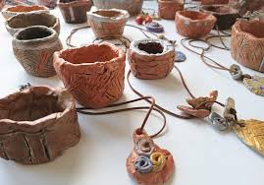
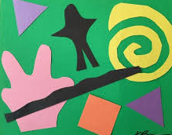



Cherry Lane Nursery Long Term Plan 25-26
 | Autumn 1 | Autumn 2 | Spring 1 | Spring 2 | Summer 1 | Summer 2
General Themes | All About me! | Festivals and celebrations! | Ticket to ride! | Homes and animals! | Smell the flowers! | Fun at the seaside!
Expressive Arts and Design Painting, 3D modelling, messy play, collage, cutting, drama, role play, threading, moving to music, clay sculptures, following music patterns with instruments, singing songs linked to topics, making instruments, percussion. Children will have opportunities to learn and perform songs, nursery rhymes and poetry linked to their work / interests and passions. | The development of children’s artistic and cultural awareness supports their imagination and creativity. It is important that children have regular opportunities to engage with the arts, enabling them to explore and play with a wide range of media and materials. The quality and variety of what children see, hear and participate in is crucial for developing their understanding, self-expression, vocabulary and ability to communicate through the arts. The frequency, repetition and depth of their experiences are fundamental to their progress in interpreting and appreciating what they hear, respond to and observe. Give children an insight into new musical worlds. Invite musicians in to play music to children and talk about it. Encourage children to listen attentively to music. Discuss changes and patterns as a piece of music develops.
 | Winter Jackson Pollock Paint flinging | Houses/homes W Kandinsky-pastel circles | Media/sculpture transport Creating with Clay | Henri Matisse - collage coloured card/paper | Flower paintings from Monet | Water themed hokusai water-paint-pastels
Creating with materials | Drawing self portraits Drawing straight lines, Creating with paper | Leaves for hedgehogs Rangoli pictures Diya lamps, coloured tissue paper for light pastels/pens Firework pictures black | Making bus tickets Making train tickets Card Hole punch pens/pencils | Creating using paper Adapting and improving our work | Children make various mini beasts out of card, pipe cleaners and googly eyes. Pasta Scissors | Children make various mini beasts out of card, pipe cleaners and googly eyes. Pasta Scissors
Being imaginative and expressive Art | Dressing up/role play Free drawing Small world play | Small world Performing on a stage Christmas play Learning and singing new songs | Junk modelling vehicles and making representations of different types of transport | Building and constructing with bricks Role play/ dressing up Designing homes for animals | Role play and dressing up Learning and performing new songs | Role play and dressing up Designing swimwear Creating maps and trails
Nursery Expressive Arts and Design Objectives/skills | • Take part in simple pretend play, using an object to represent something else even though they are not similar. • Begin to develop complex stories using small world equipment like animal sets, dolls and dolls houses etc. • Make imaginative and complex ‘small worlds’ with blocks and construction kits, such as a city with different buildings and a park. • Explore different materials freely, to develop their ideas about how to use them and what to make. • Develop their own ideas and then decide which materials to use to express them. • Join different materials and explore different textures.• Create closed shapes with continuous lines, and begin to use these shapes to represent objects. • Draw with increasing complexity and detail, such as representing a face with a circle and including details. • Use drawing to represent ideas like movement or loud noises. • Show different emotions in their drawings and paintings, like happiness, sadness, fear etc.• Explore colour and colour-mixing. • Listen with increased attention to sounds. • Respond to what they have heard, expressing their thoughts and feelings. • Remember and sing entire songs. • Sing the pitch of a tone sung by another person (‘pitch match’). • Sing the melodic shape (moving melody, such as up and down, down and up) of familiar songs. • Create their own songs or improvise a song around one they know. • Play instruments with increasing control to express their feelings and ideas.

